Slide 1
Research Ideas

Slide 2
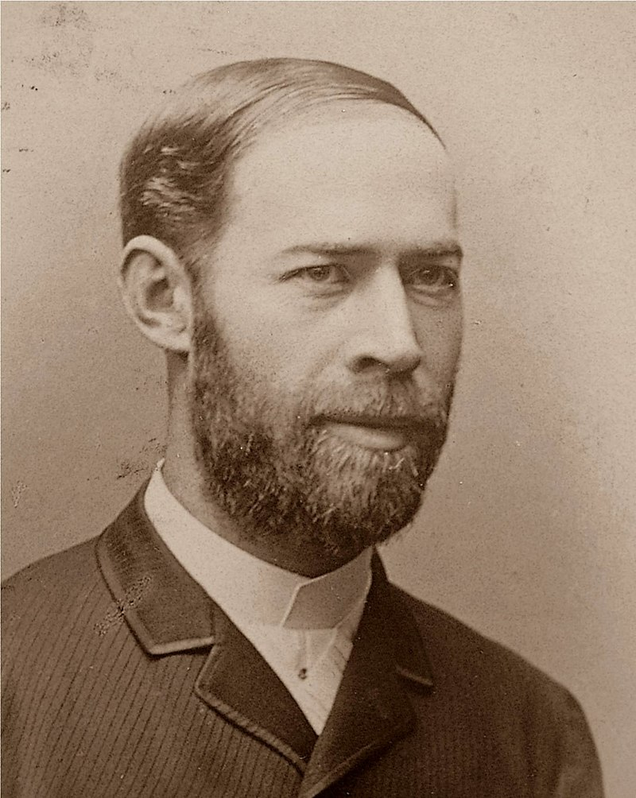
Picking a research topic
First and foremost, pick something you find interesting.
There is always a pressure in science for immediate applications
Revisiting Basic vs applied research
Basic Research – no immediate goal
Applied Research – immediate goal
Heinrich Hertz
German physicist who expanded on the electromagnetic theory of light
Studied light and electricity
“It’s of no use whatsoever… we just have these mysterious electromagnetic waves that we cannot see with the naked eye. But they are there”.

Slide 3
Picking a research topic
There are virtues of basic research, and we never know what will end up being useful
“what is a baby good for?”
No point in doing “useful” things that you’re not suited for
The point is – follow your talents and interests.
Some good tips on developing a good research topic.
https://www.youtube.com/watch?v=nXNztCLYgxc&feature=youtu.be

Slide 4
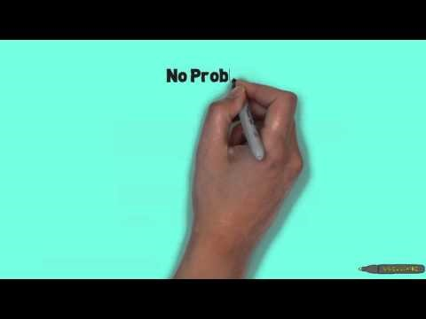

Slide 5
Reviewing the research literature
Literature Search
Read previously published work to see if your idea has already been done
Get ideas from similar work
Don’t reinvent the wheel!
“If I have seen further, it is by standing on the shoulders of giants” – Isaac Newton
Books, journals, databases (e.g. PsycINFO, GoogleScholar)

Slide 6
Reviewing the research literature
Professional journals
Periodicals that publish original research articles.
There are tons of them!
Psychological Science, Nature, Psychonomic Bulletin & Review, etc.
There are different types of articles
Empirical research reports
Review articles
Theoretical article
Peer-review

Slide 7
Reviewing the research literature
Scholarly Books
Written by researchers mainly for use by other researchers and practitioners.
Monograph – written by a single author or small group of authors. Similar to an extended review article
Edited Volumes – editors that recruit many authors to write separate chapters on different aspects of the same topic.
Peer review

Slide 8
Reviewing the research literature
PsycINFO
Maintained by the APA.
Available through the university library.
https://library.missouri.edu/databases/
Google Scholar
https://scholar.google.com/
Titles of articles, keywords, journal name, publication date, etc

